Slide 1


POWER QUALITY IMPROVEMENT OF A WIND ENERGY GRID CONNECTED SYSTEM USING STATCOM CURRENT CONTROLLER
Under the esteemed guidance of
Mr. B. V. S. Prahasith Dasari , M.Tech
PROJECT ASSOCIATES
V.Gayatri Prathyusha 10F01A02B2
P.Thulasi Thirupathi Rao 10F01A0287
N.S Laxmi Yadav 10F01A0281
SK.Fahima 10F01A02A3

Slide 2
ABSTRACT
Wind power connected to the electric grid effects the power quality.
Variations of voltage, flickers, active, reactive power and harmonics are the effects of power quality.
STATCOM connected at the common coupling point reduces the power quality problem.
Simulated using MATLAB/SIMULINK in power system block set

Slide 3

The proposed STATCOM control scheme for grid connected wind energy generation for power quality improvement has following objectives.
• Unity power factor at the source side.
• Reactive power support only from STATCOM to wind Generator and Load.
• Simple bang-bang controller for to achieve fast dynamic response.

Slide 4
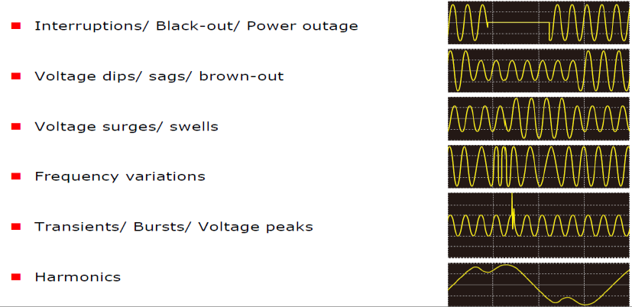
CLASSIFICATION OF POWER DISTURBANCES

Slide 5
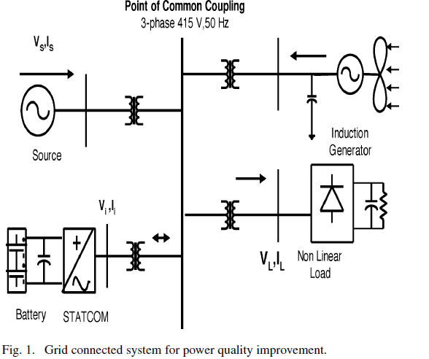
Fig. 1. Grid connected system for power quality improvement

Slide 6
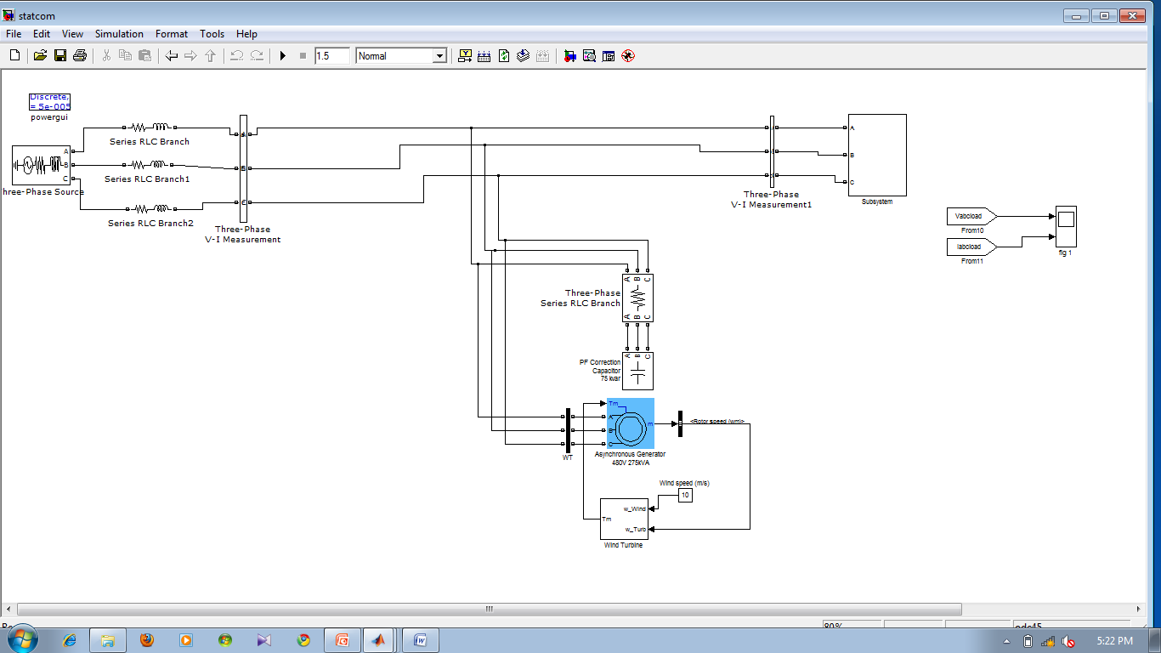
FIG: MATLAB SIMULINK CIRCUIT FOR GRID SYSTEM WITH OUT STATCOM

Slide 7
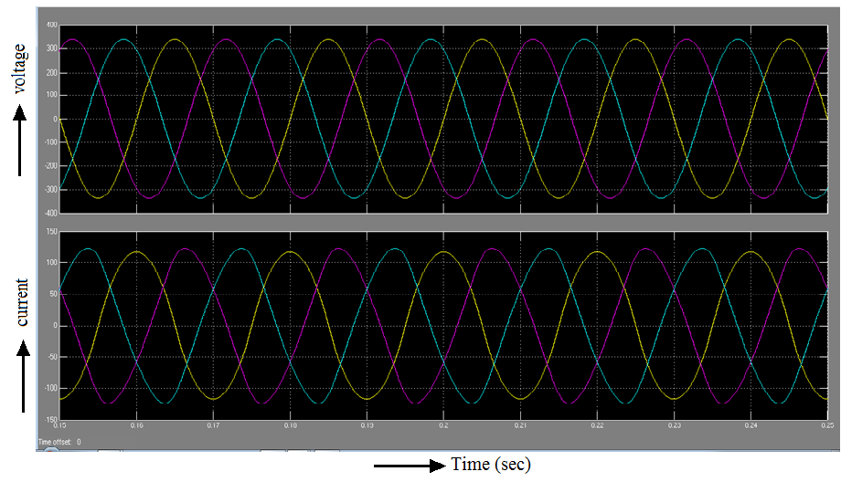

Voltage and current waveforms
At source side

Slide 8
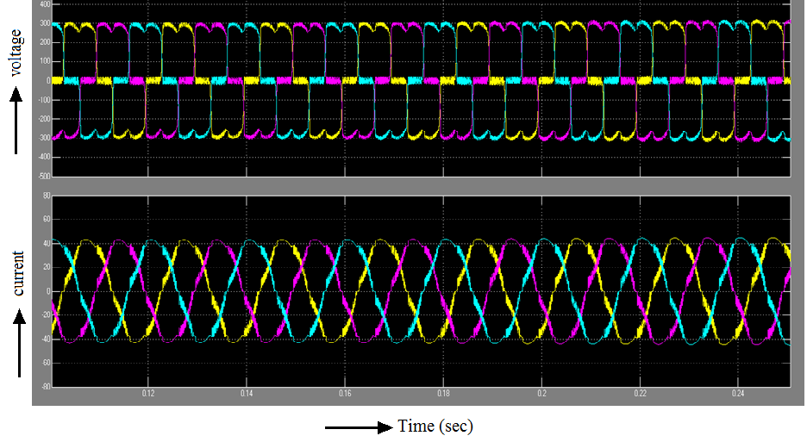
At load side

Slide 9
STATCOM – Static Synchronous Compensator
A shunt-connected reactive power compensation device
In general a solid-state switching converter capable of generating or absorbing independently controllable real and reactive power
A STATCOM can improve power-system performance in
a. The power-oscillation damping in power transmission systems.
b. The dynamic voltage control in transmission and distribution systems.
c. The transient stability.
d. The voltage flicker control.

Slide 10
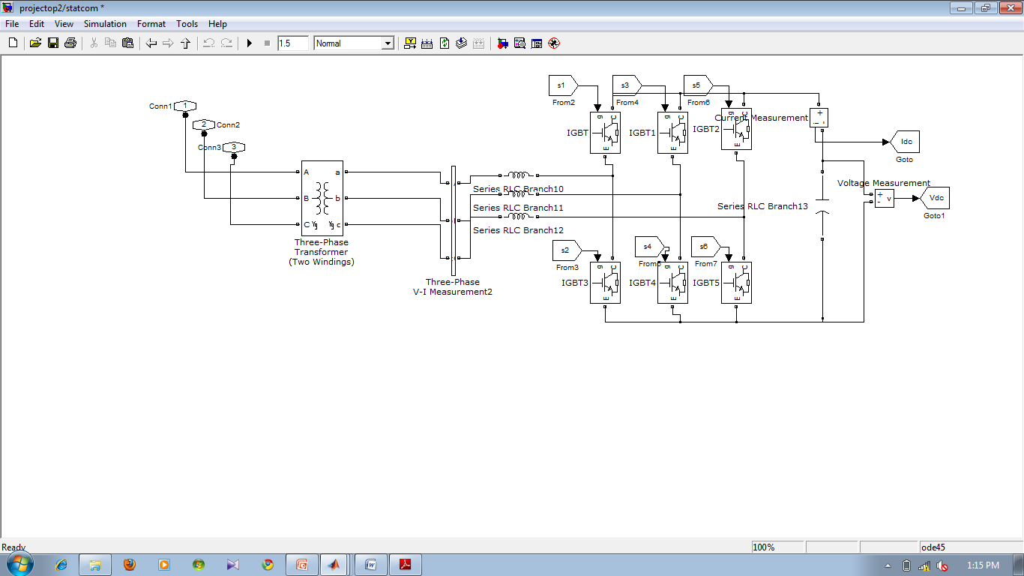
MATLAB MODEL FOR STATCOM

Slide 11
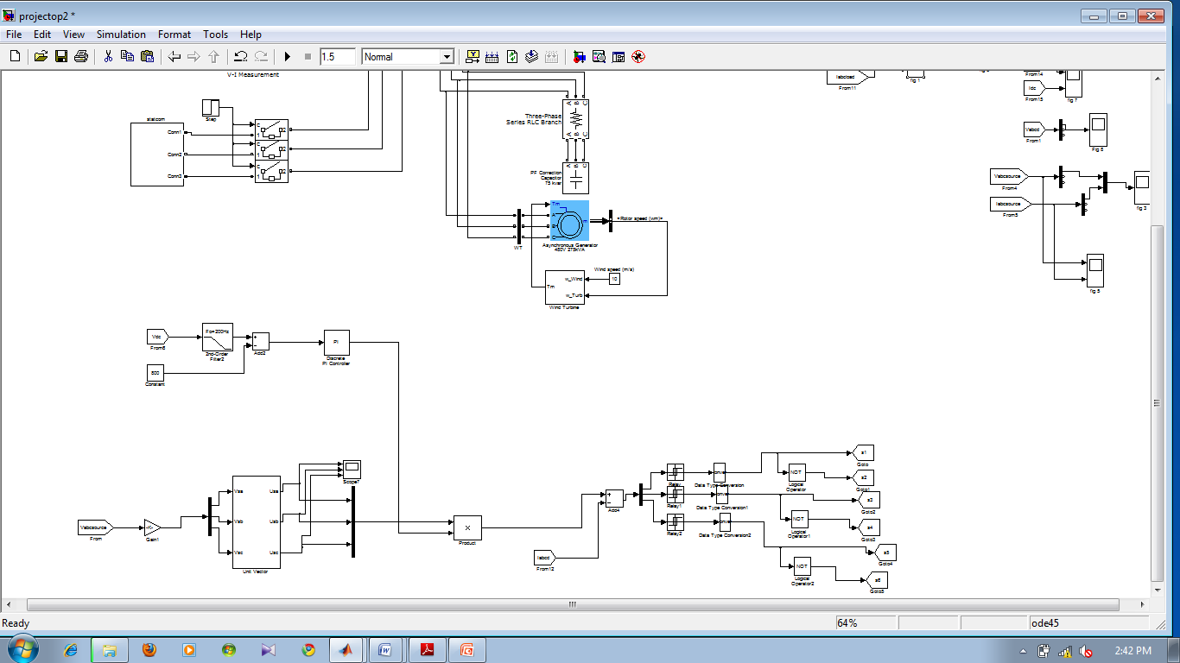
CONTROL SCHEME:
Is based on injecting the currents into the grid using bang-bang controller.
Uses a hysteresis current controlled technique.

Slide 12
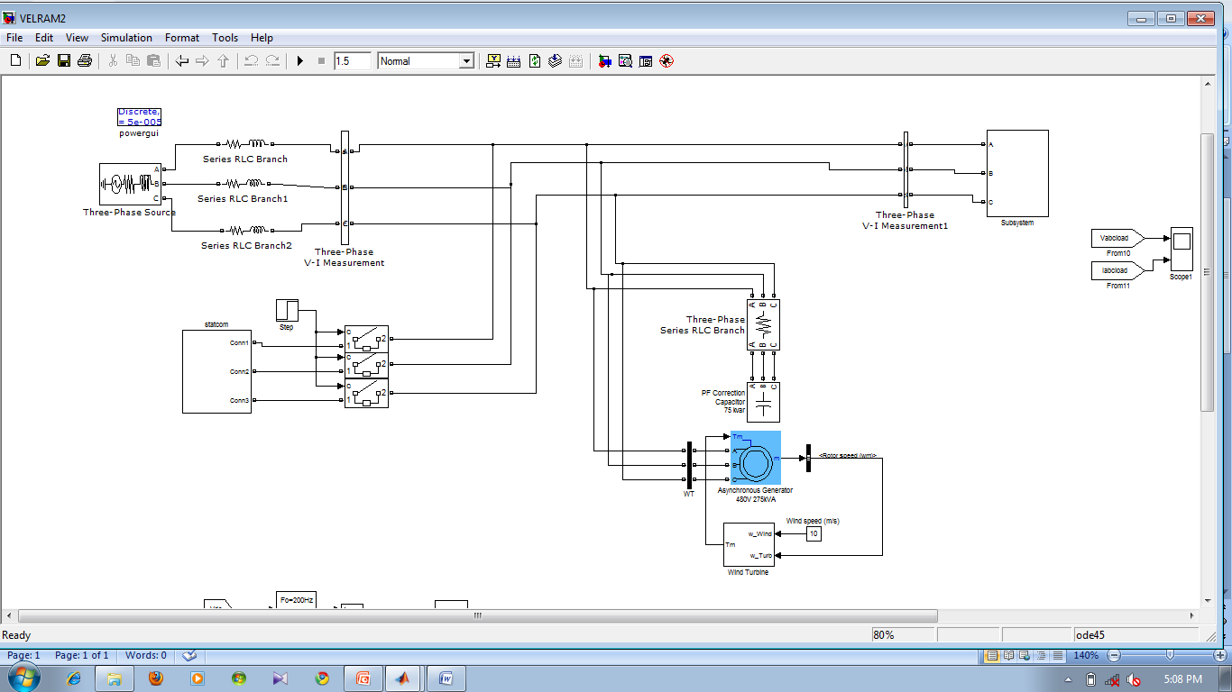
Fig. Matlab simulink circuit for grid connected system with STATCOM.

Slide 13
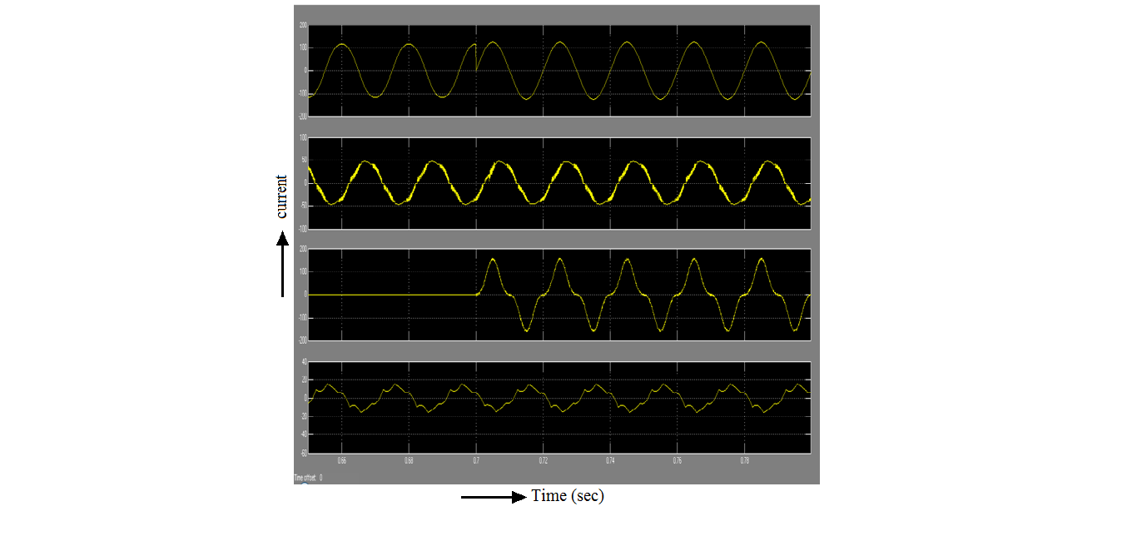
SOURCE CURRENT
LOAD CURRENT
INVERTER INJECTED CURRENT
WIND GENERATOR
CURRENT

Slide 14
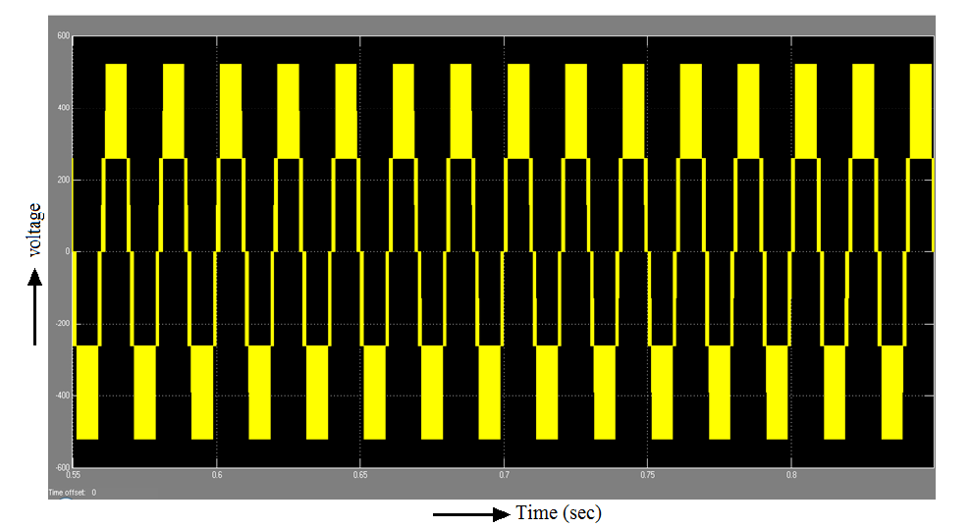

Slide 15

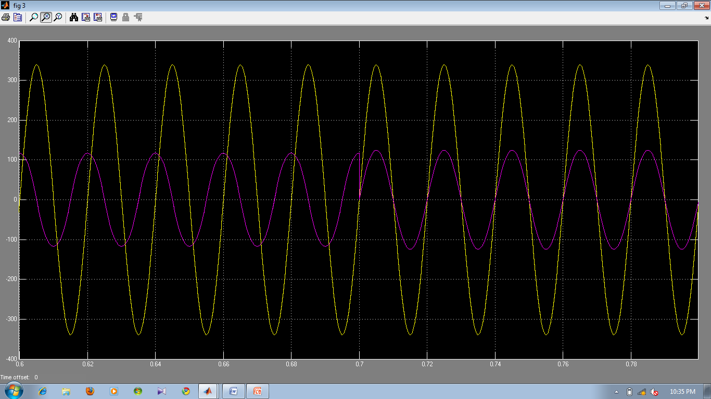
Time(Sec)

Slide 16
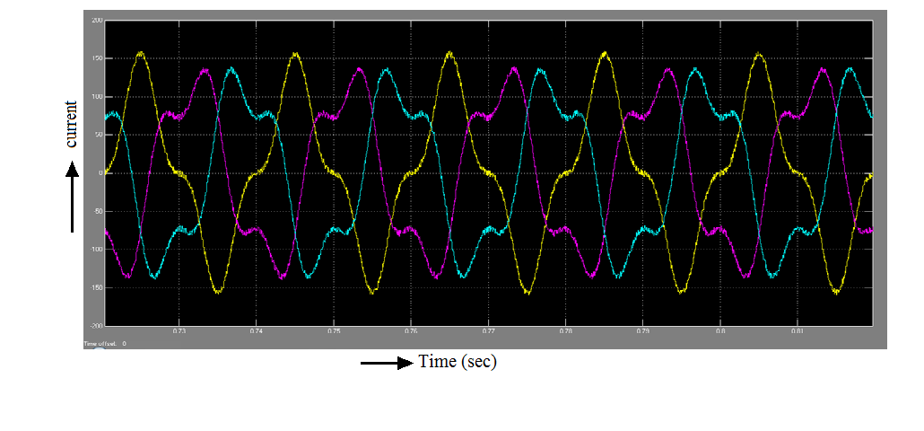

Slide 17
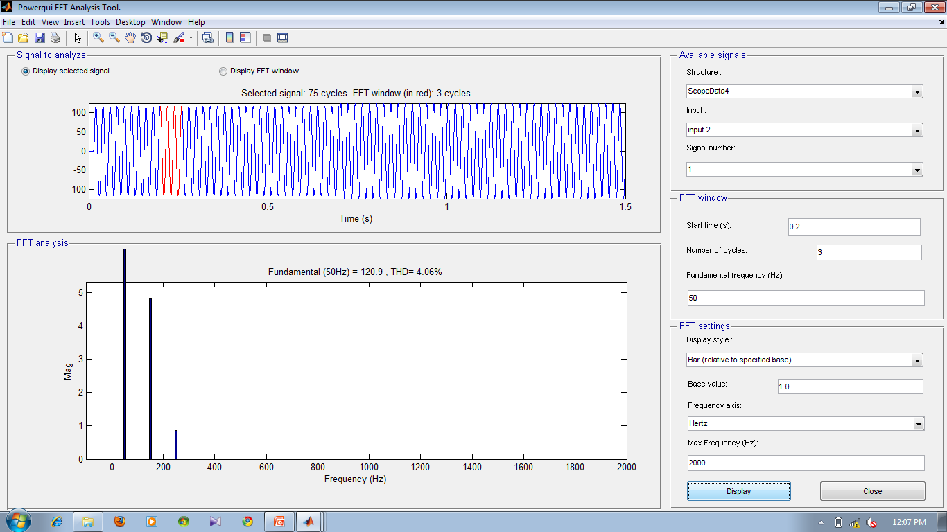

Slide 18
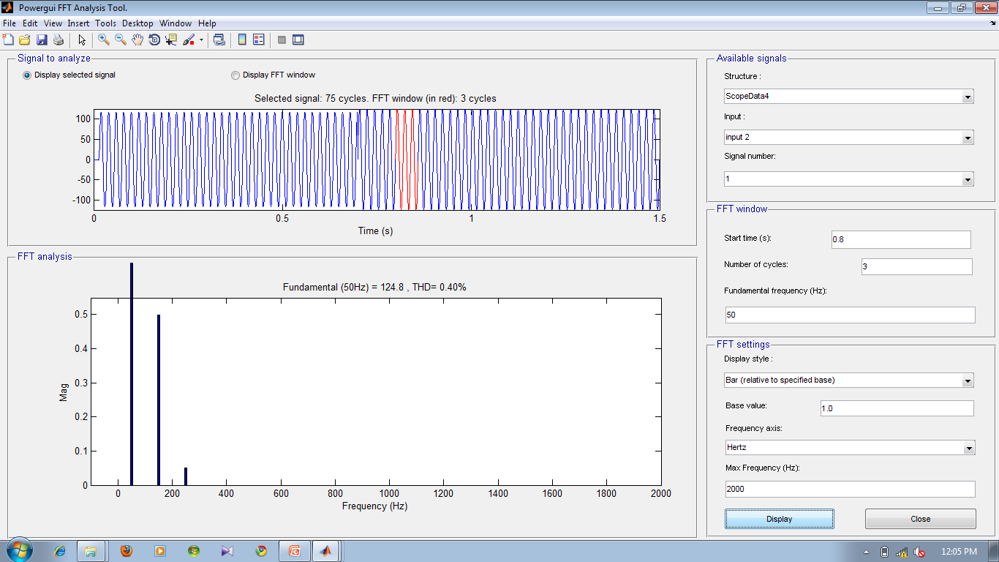

Slide 19
CONCLUSION:
Presents the STATCOM-based control scheme for reactive power compensation and harmonic reduction in grid connected wind generating system feeding non linear load
Simulation results shows the grid voltage and current are in-phase, making the power factor unity
%THD improved from 4.06 to 0.4 with compensation

Slide 20


Slide 21


